Slide 1
SAS Project: PA Vehicle Accidents Report
Matt Chylack, Ben Phillippy, Jayden Carlucci, and Matt Granato

Slide 2
Executive Summary
Analyze the variables that go into car crashes in Pennsylvania from the years 2016-2021
Define/categorize variables which have most influence on severity of car crash
Help state/local officials minimize severity of crashes

Slide 3

Why It Matters
Make people more aware of crash risk in order to help decrease the amount of crashes
Help people become more aware of dangerous road conditions
Influence drivers to be safer/drive in adequate conditions
Influence lawmakers to make appropriate driver safety laws to decrease injury/deaths tolls

Slide 4
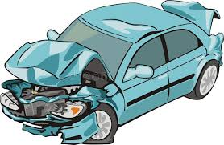
Project Motivation
Understanding what causes long traffic backups in Pennsylvania
Help drivers understand what variables cause the most risk for accidents
Give local organizations reasons to make appropriate changes to roadways/appropriate warnings for inclement weather

Slide 5

Data Description
Original data consisted of info from 49 states and 2.7 million records
Multiple methods used to collect data of incident-Traffic cameras, police reports, traffic sensors
All data was reported to Department of Transportation

Slide 6


Data Cleanings
Report consists of data solely from Pennsylvania
41,850 rows/46 columns
Omitted non-nullable values

Slide 7

Data Preparation Activities
Imported file into Sas
Edited variables to appropriate Role and Level
Assigned Distance_mi as target variable; Distance (miles) of traffic backup during accident
Rejected Severity-Will be known afterwards by distance of backup

Slide 8
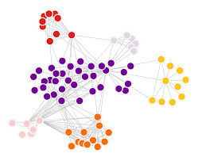
Models/Diagrams Used
First added node was Cluster Analysis
Found that more significant accidents occur during daytime
Accidents more likely to occur near sunrise/sunset
More likely to have significant accident in foggy condition or thunderstorm
Distance_mi and true/false Sunrise/Sunset are top 2 variables of significance

Slide 9
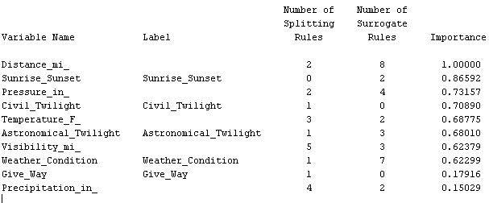
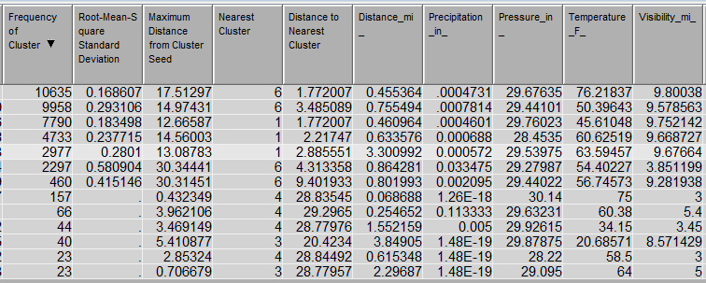
Variables of Highest Significance

Slide 10

Tests Ran
Ran three tests-Neural Network, Decision Tree, & Regression
Used to predict distance of backup
Using Model comparison we found Decision Tree to be most accurate model for predicting crash backup distance
Had lowest AVG squared error of 2.37

Slide 11

Testing Various Decision Trees
Adjusted max number of branches & maximum depth
Best model came out to be one having 3 branches and depth of 6
Had average Squared Error of 2.37

Slide 12

Findings
Variables within our dataset made it difficult to accurately predict factors that cause traffic delays for accidents
Concluded that more traffic on roads results in higher likelihood of accident delaying traffic
Majority of the large traffic delays occurred in daytime hours followed by near sunrise/sunset

